Slide 1
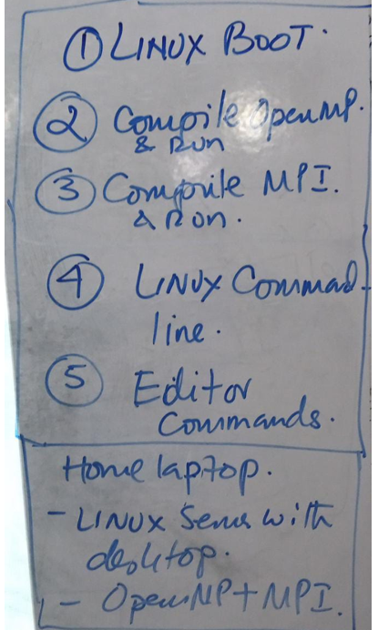
Lab # 1 (Week # 3)
OS OpenMP Lab - Review
OpenMP Introduction
OpenMP Execution
#pragma omp parallel

Slide 2



Slide 3
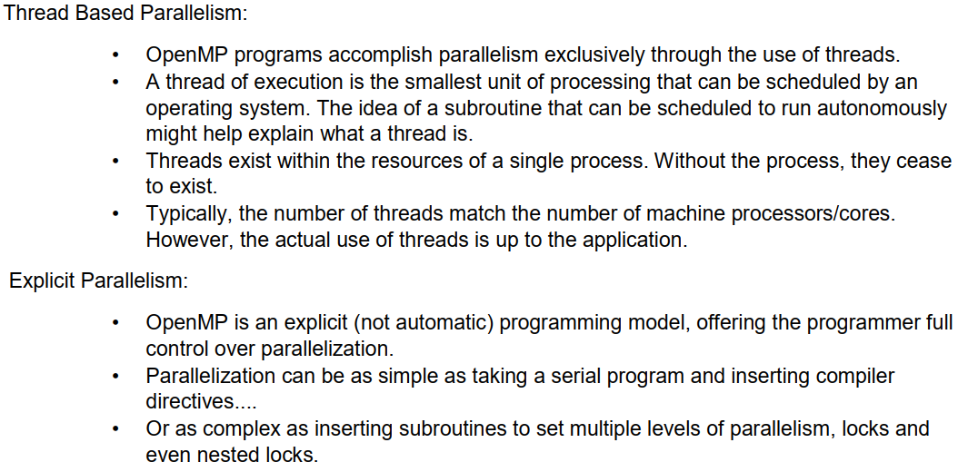

Slide 4
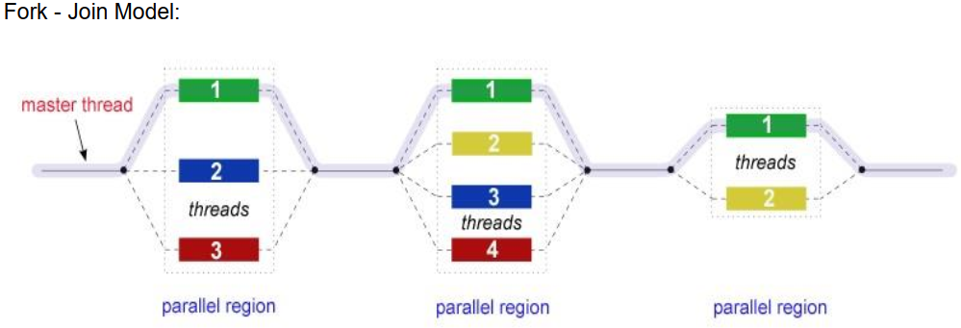

Slide 5
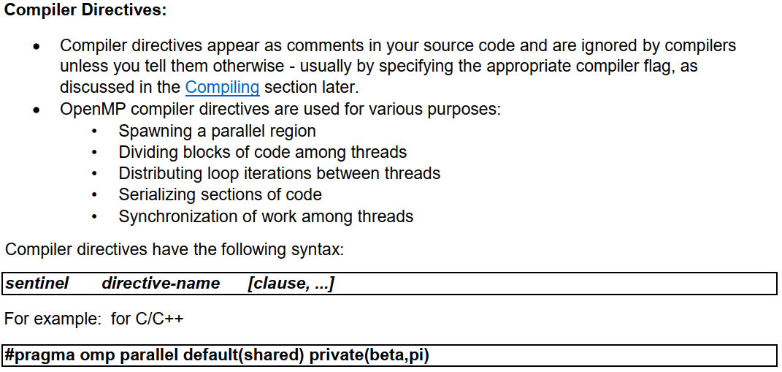

Slide 6
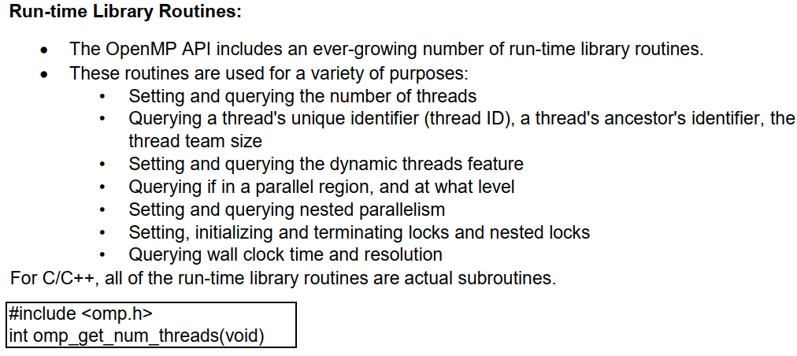
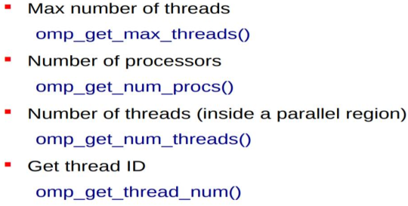

Slide 7
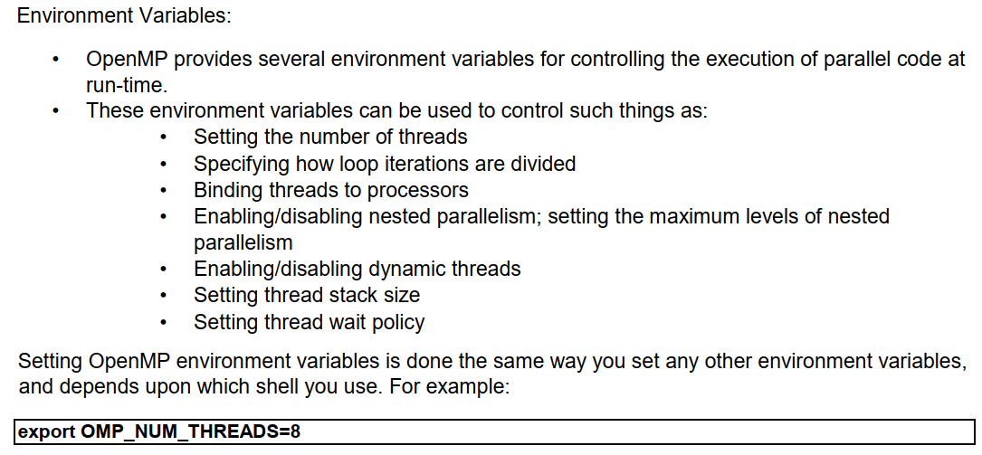

Slide 8
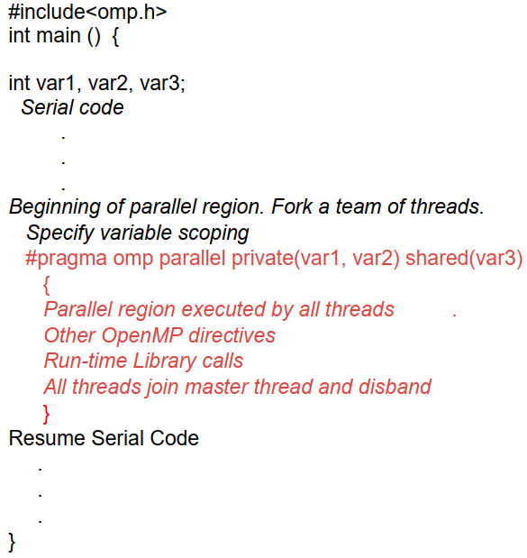
Using OpenMP primitive and APIs in your serial code

Slide 9

Compiling and Running the code

Slide 10
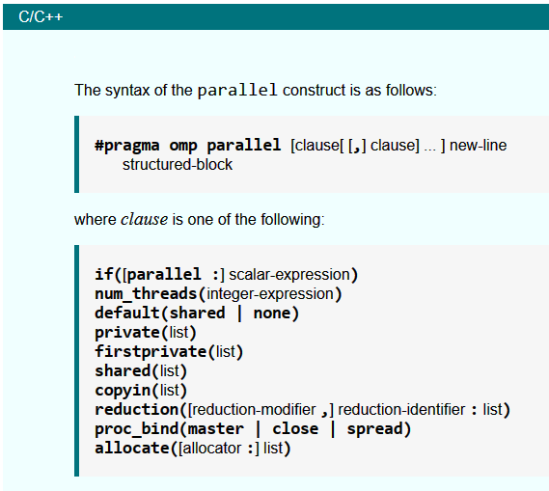
https://www.openmp.org/spec-html/5.0/openmpse14.html

Slide 11
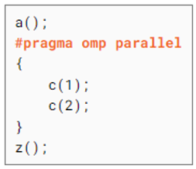
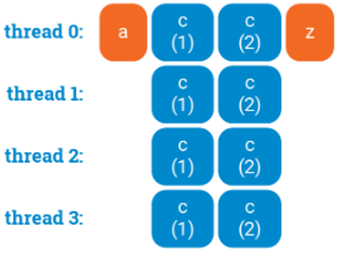

Slide 12
